Slide 1

W.H.O. Life Expectancy: Determining the mortality rate across the world.
Final project for data analysis and project management Bootcamp

Slide 2
AGENDA
About Me
Objectives
​Excel Findings
SQL Analyses
​Dash-Board
Recommendations, Insight, and Challenges
Conclusions and Key Learnings

Slide 3

ABOUT ME
I had a career break in 2022 to move to the UK for my Masters degree in Accounting and Finance.
I am a Finance expert and Accountant with 10+ Experience across, Fintech, Telecoms and emerging markets.
My analytical mind motivated me to research more on how I can manipulate and analyze data for business decision- making. With Fintech being the new face of Finance I decide to up my skill in tech to add value to myself and incorporate the skill in actualizing my long-term career goal.

Slide 4
OBJECTIVE
I am working with a dataset on world health organisation life expectancy across the world, given different causes of mortality in the countries with the gross domestic product and population between year 2000 – 2015.
To determine the country with the highest lowest adult mortality rate.
To determine the year with the highest Infant deaths.
To determine then trend of the total expenditure incurred by W.H.O to reduce mortality over the year reviewed.
To find out the country with the highest population for the period and compare the rate of mortality to population.

Slide 5
EXCEL FINDINGS
IF function was used to put life expectancy age for each country into a bracket such as “Ripe Age”, “Aged” and “Early deaths”.
SUMIF function was used to determine the total adult mortality for each country.
Pivot table was used to determine the percentage of infant deaths between year 2000 and 2015 to get the year that has the highest value of infant death.
MAX and MIN function was used to know the country with highest number of adult mortality and the lowest number of mortality between year 2000 and 2015.

Slide 6
EXCEL VISUALISATION USING PIVOT

Slide 7

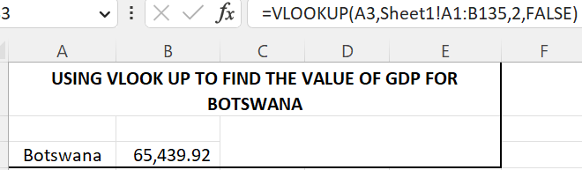
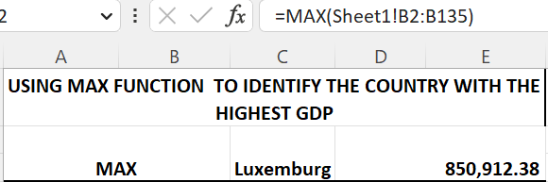
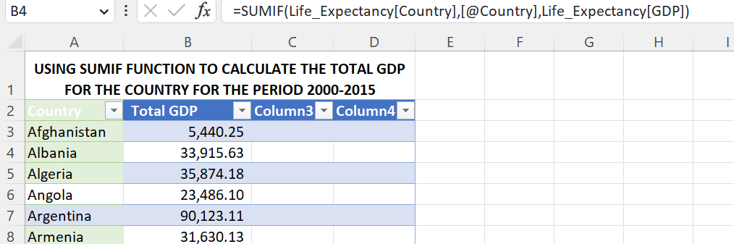
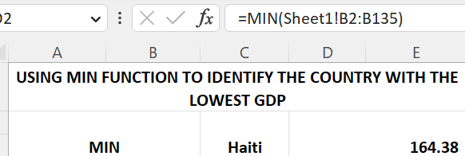
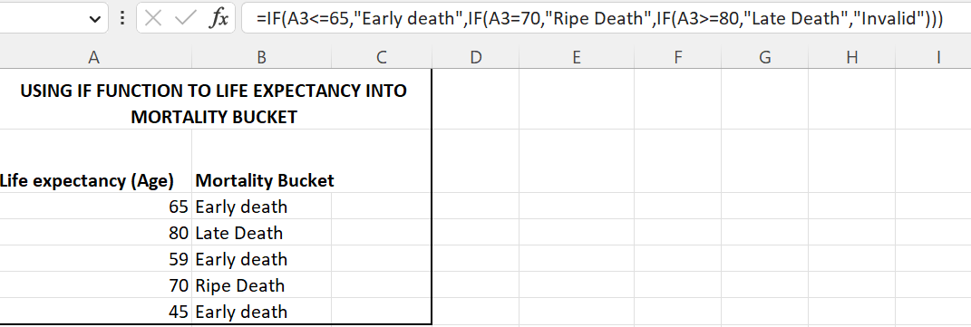
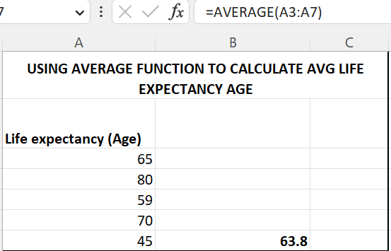
This Photo by Unknown Author is licensed under CC BY-NC

Slide 8

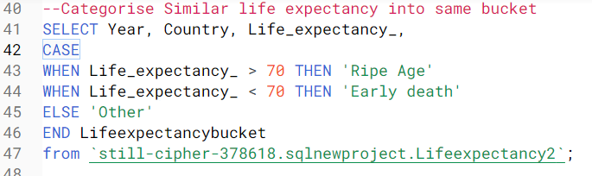
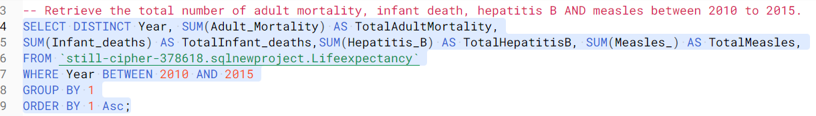
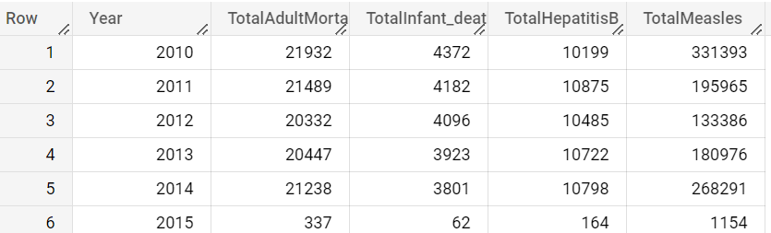
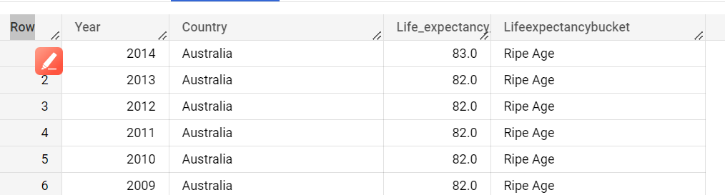
SQL ANALYSIS

Slide 9
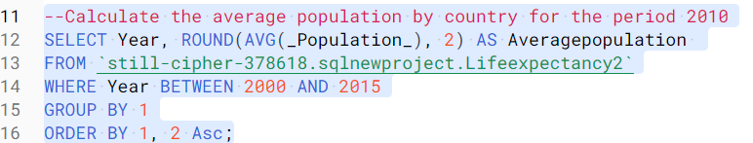
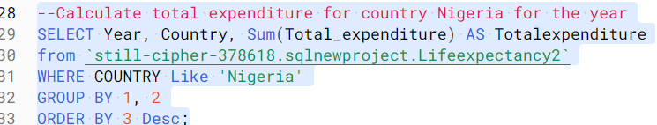
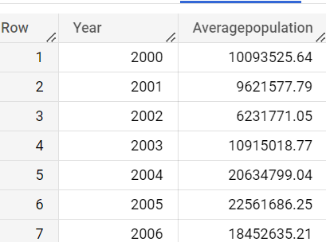
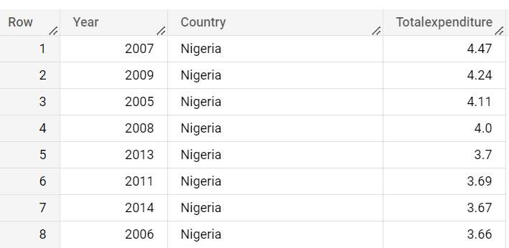

Slide 10

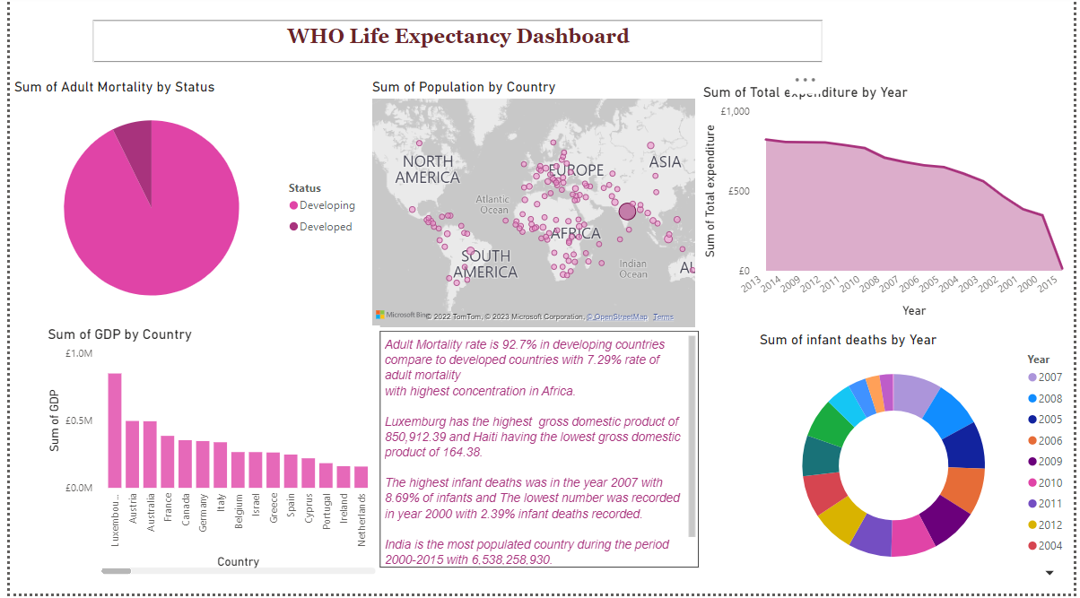
Data visualization using Power BI
This Photo by Unknown Author is licensed under CC BY

Slide 11
RECOMMENDATIONS, INSIGHTS, AND CHALLENGES
INSIGHTS
Adult Mortality rate is 92.7% in developing countries compare to developed countries with 7.29% rate of adult mortality with highest concentration in Africa.
Luxemburg has the highest gross domestic product of 850,912.39 and Haiti having the lowest gross domestic product of 164.38.
The highest infant deaths was in the year 2007 with 8.69% of infants and The lowest number was recorded in year 2000 with 2.39% infant deaths recorded.
India is the most populated country during the period 2000-2015 with 6,538,258,930.
RECOMMENDATIONS
Infant and child mortality can be reduced dramatically through breast-feeding, adequate nutrition, safe water, health and population education, immunization programs, oral rehydration therapy and birth spacing.

Slide 12
Based on the analysis, the rate of mortality in developing country is higher than developed countries which can be argued to be achieved through higher standards of living, more effective health systems, and more resources invested in determinants of health (e.g. sanitation, housing, education). It is suggested that if more allocation can be given to basic amenities in the developing countries, the life expectancy will increase.
CHALLENGES
Cleaning of data and transforming was time-consuming and tedious.
Generating the main objectives to work with required a lot of mental reasoning
A lot of error came up while writing SQL code as a result of missing out codes before running

Slide 13
REFLECTION- CONCLUSION AND KEY LEARNINGS
The major key learnings for me about the bootcamp are:
Determination and being resilient is the key to success
Writing codes and visualizing data is the highlight for me on this program.
I have gained so much confidence in analyzing data using tools such as Excel, Tableau and Power BI which was my main reason of applying for the bootcamp.
Niyo Bootcamp for me is a program that encompasses a lot of things outside data analysis and project management. The mentoring program I was opportune to be part of (Capgemini) really changed my thinking and boost my confidence attending interviews. All the people I encountered on this journey from the facilitators, HR support, the CEO and the program coordinator were all supportive and always willing to help when requested. I always look forward to the classes despite my tight schedule joggling between school and childcare because is always engaging and insightful.
I am currently open to work with a consultancy firm and to learn more on big data manipulation and analysis.

Slide 14
THANK YOU
LinkedIn: linkedin.com/in/funmi-aregbesola
| GitHub: github.com/Phummzie27

Slide 15
QUESTIONS

